Slide 1
Photomicrographs of Plant foods
Okra
Permission to reproduce original photomicrographs used to make this collection may be obtained from
Dr. David O. Norris at
david.norris@colorado.edu

Slide 2
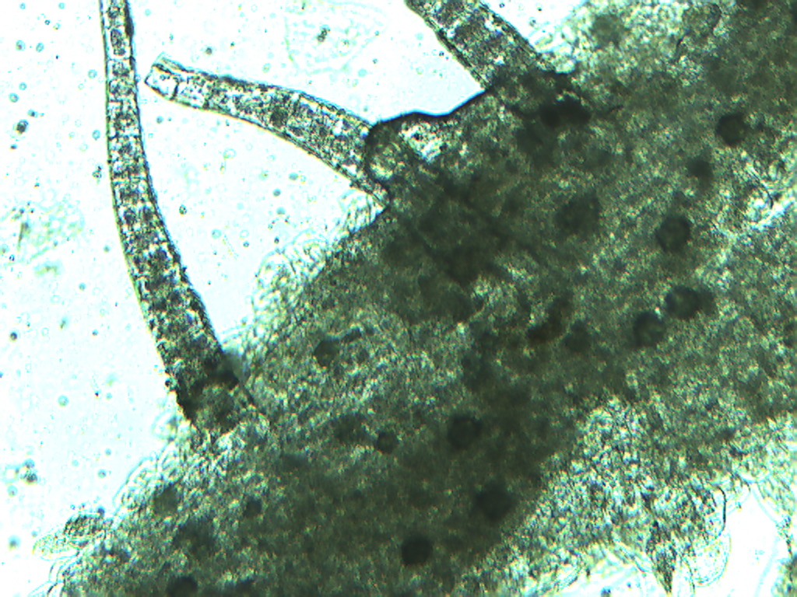
Notes:
295. Abelmoschus esculentus (L.) Moench. Okra. Pod surface exhibits multicellular trichomes, 10X.

Slide 3
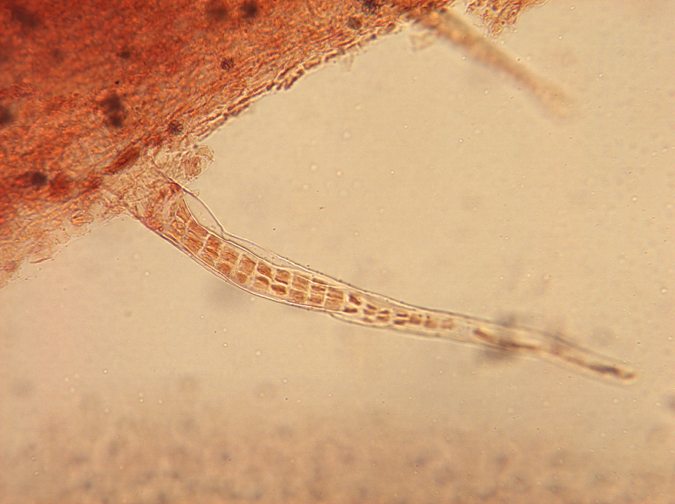
Notes:
296. Okra; multicellular trichome on pod surface stained with safranin, 10X

Slide 4
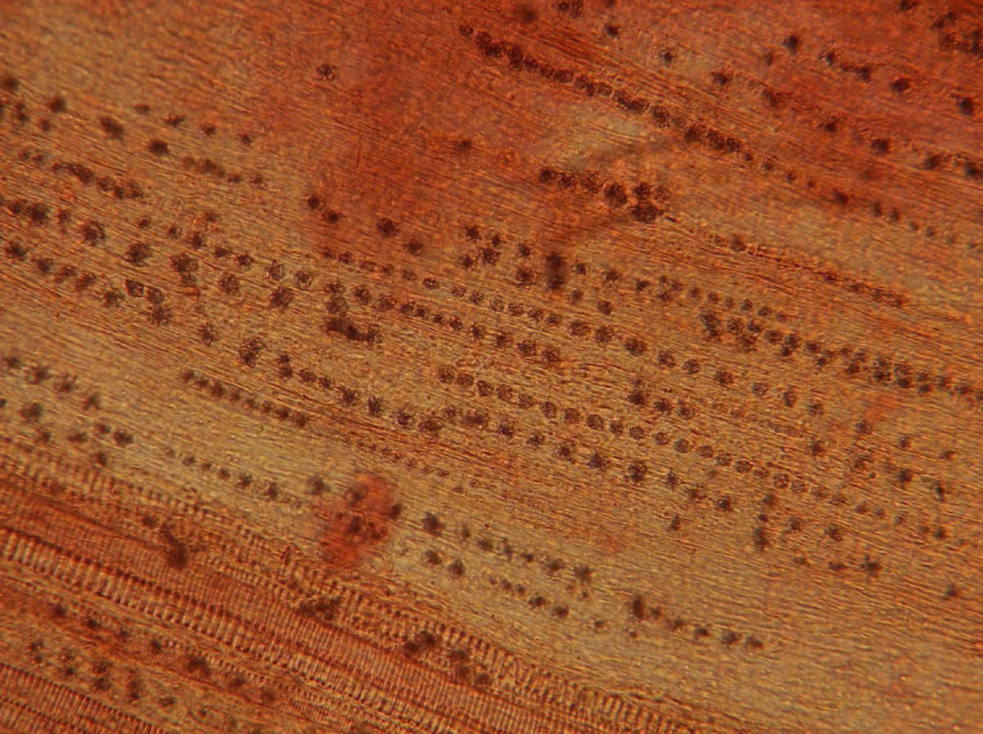
Notes:
297. Okra. Pod with druse crystals in parallel rows: vascular tissue (arrows), 10X.

Slide 5
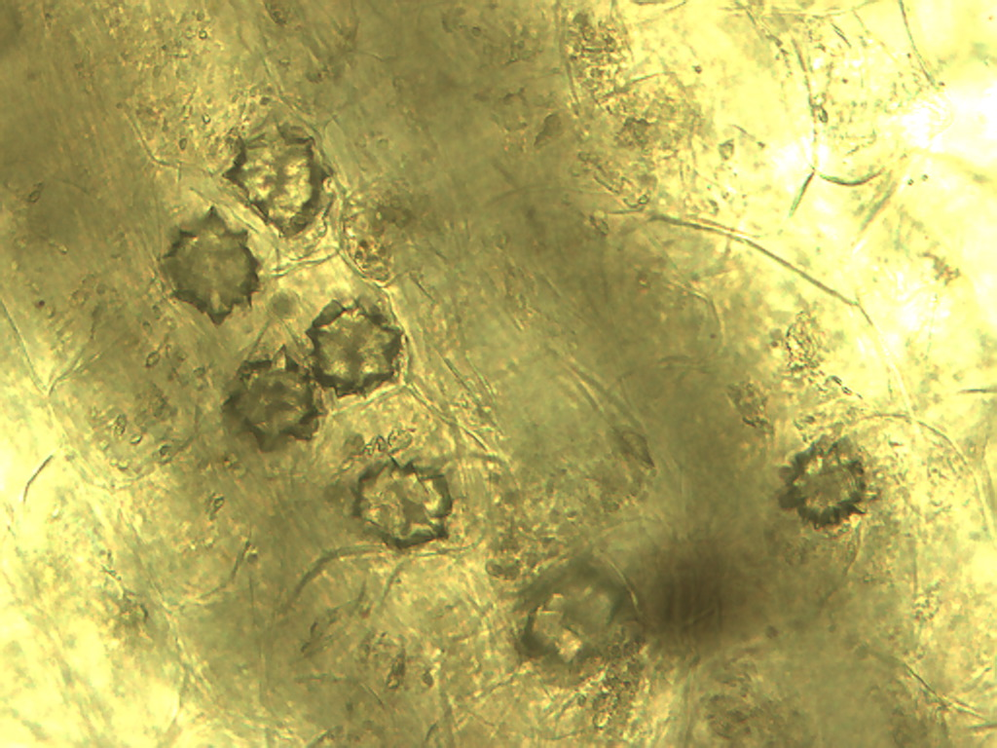
Notes:
298. Okra. Druse crystals in pod, 40X.

Slide 6
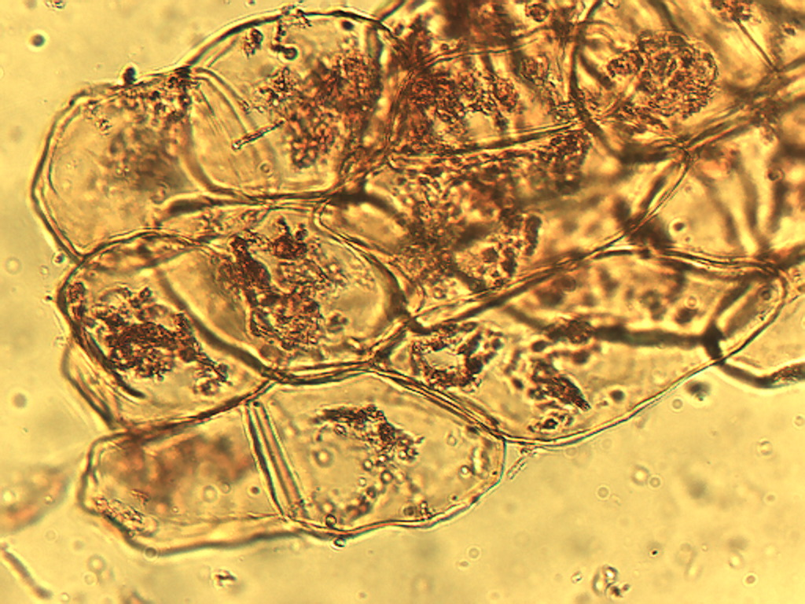
Notes:
299. Okra. Parenchymal pulp cells in pod stained with safranin, 25X.

Slide 7
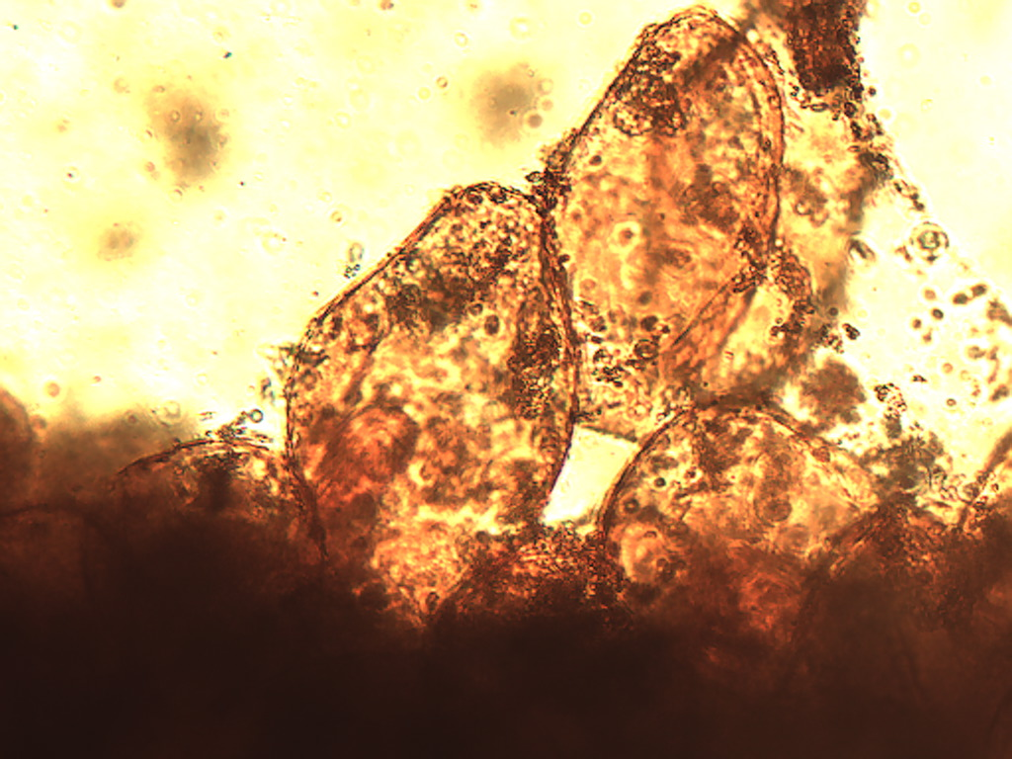
Notes:
300. Okra. Pod pulp parenchymal cells stained with safranin, 40X.

Slide 8
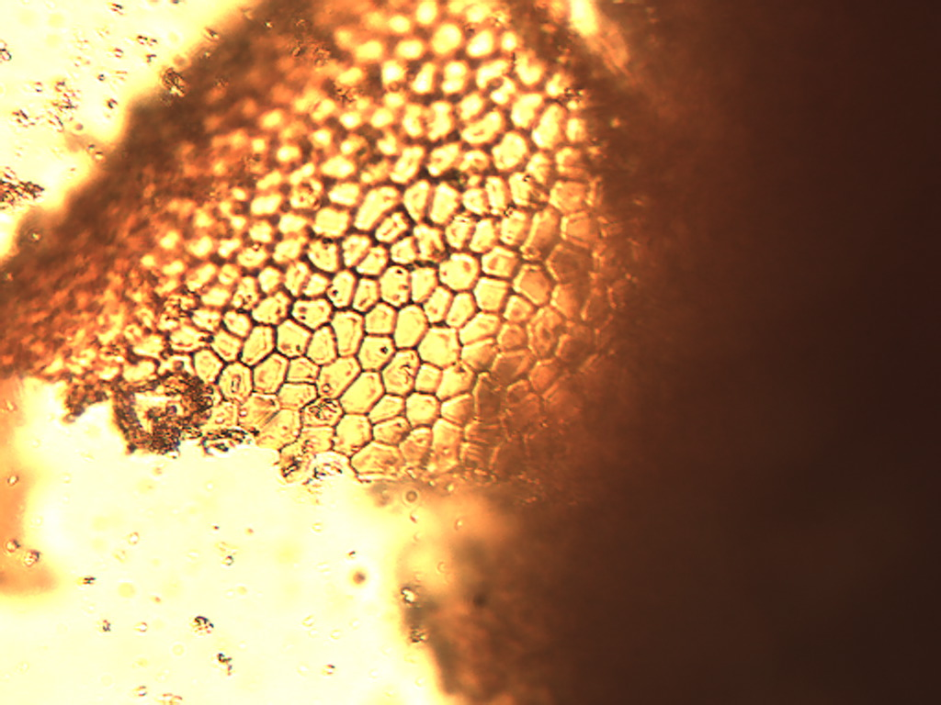
Notes:
301. Okra. Seed coat (testa) epidermis, 25X.

